Slide 1
Dashcam-pipeline

Slide 2
1. Fetch the Google data (Use info_3d)
Road
Info_3d
Google street view
Google street view
(existed but
not yet founded)

Slide 3
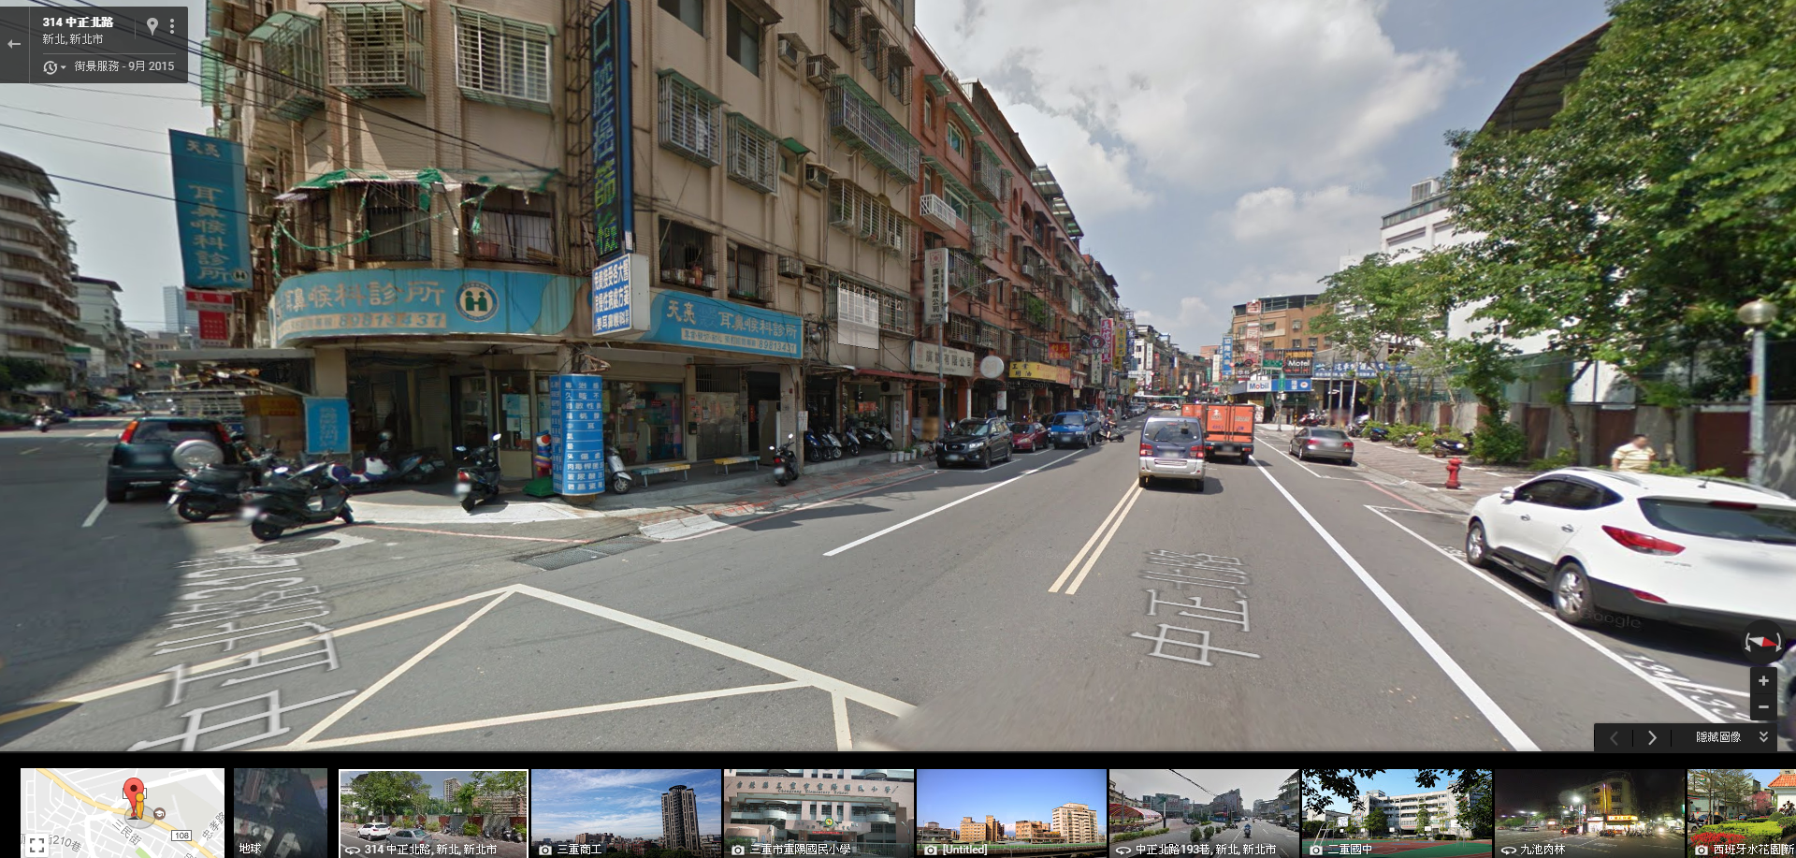
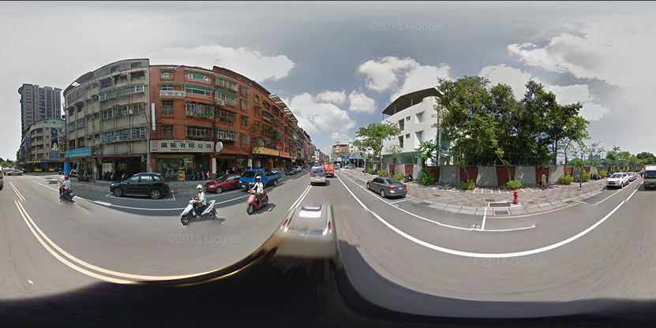
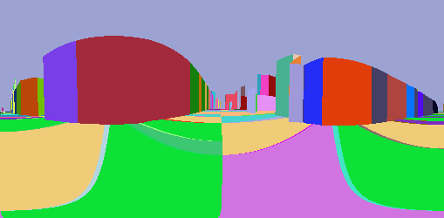
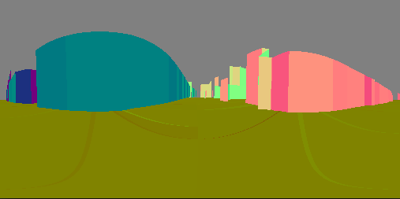

Slide 4
*Create street view 3D (check another material for details)
Road
SV3D (point cloud)
Google street view

Slide 5
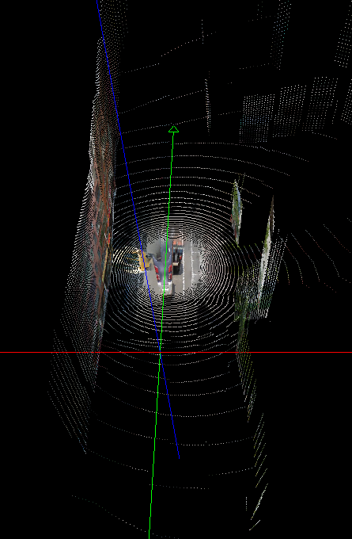
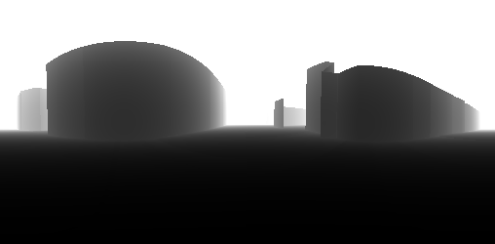

Slide 6
2.Transform the point in SFM to Google (SV3D)
Road
SV3D (point cloud)
Google street view
SFM point in SV3D

Slide 7
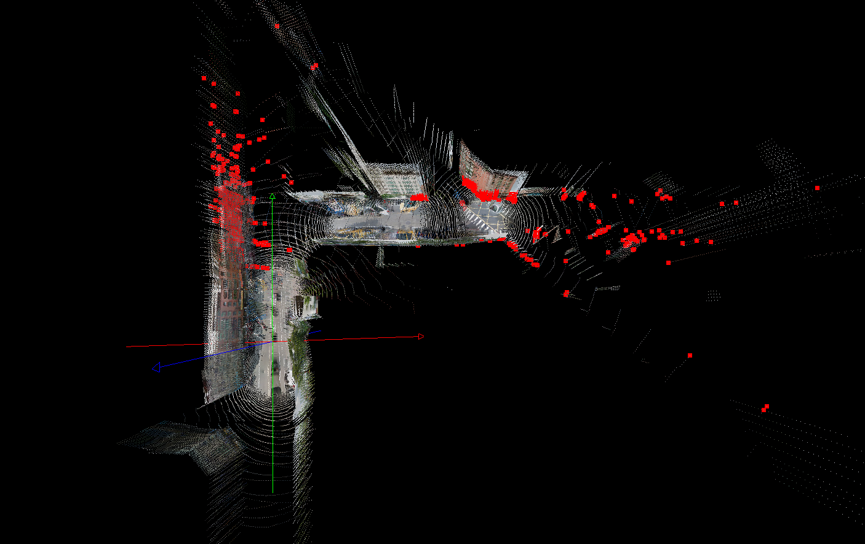

Slide 8
3.Align the SFM with Google(By sfm3DRegion.matrix)
Trajectory
SFM
SFM point in SV3D

Slide 9
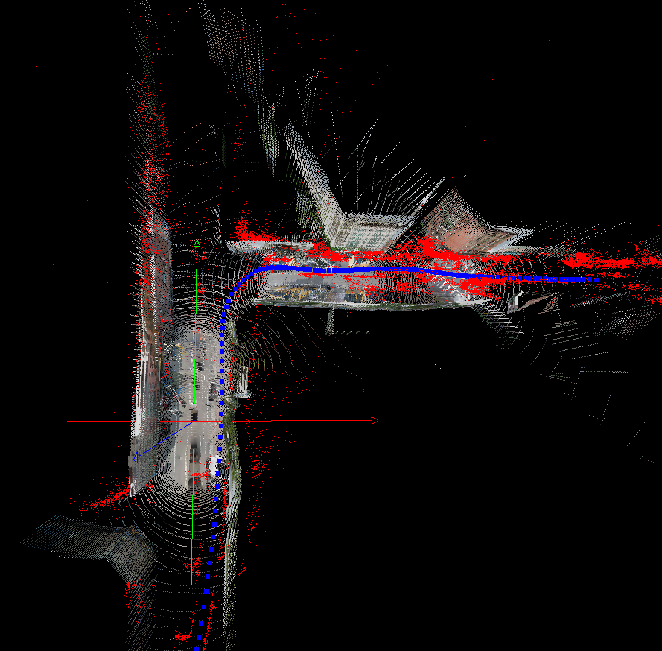

Slide 10
4.Output the trajectory in (lat, lon, h)/(x, y, z) form
Trajectory point
Trajectory
SFM
SFM point in SV3D

Slide 11
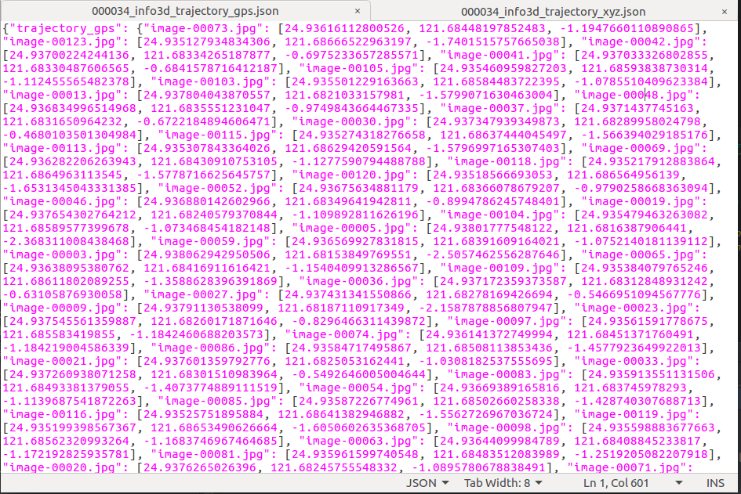
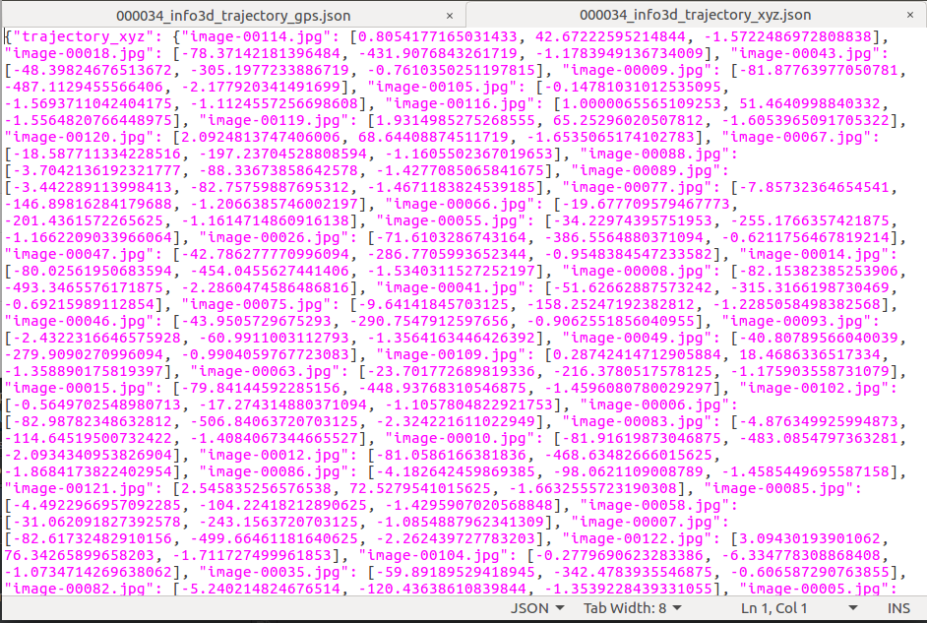

Slide 12
5.Fetch the Google data (Use trajectory)
Road
Google street view
(new founded)
Google street view
Trajectory point
Trajectory

Slide 13
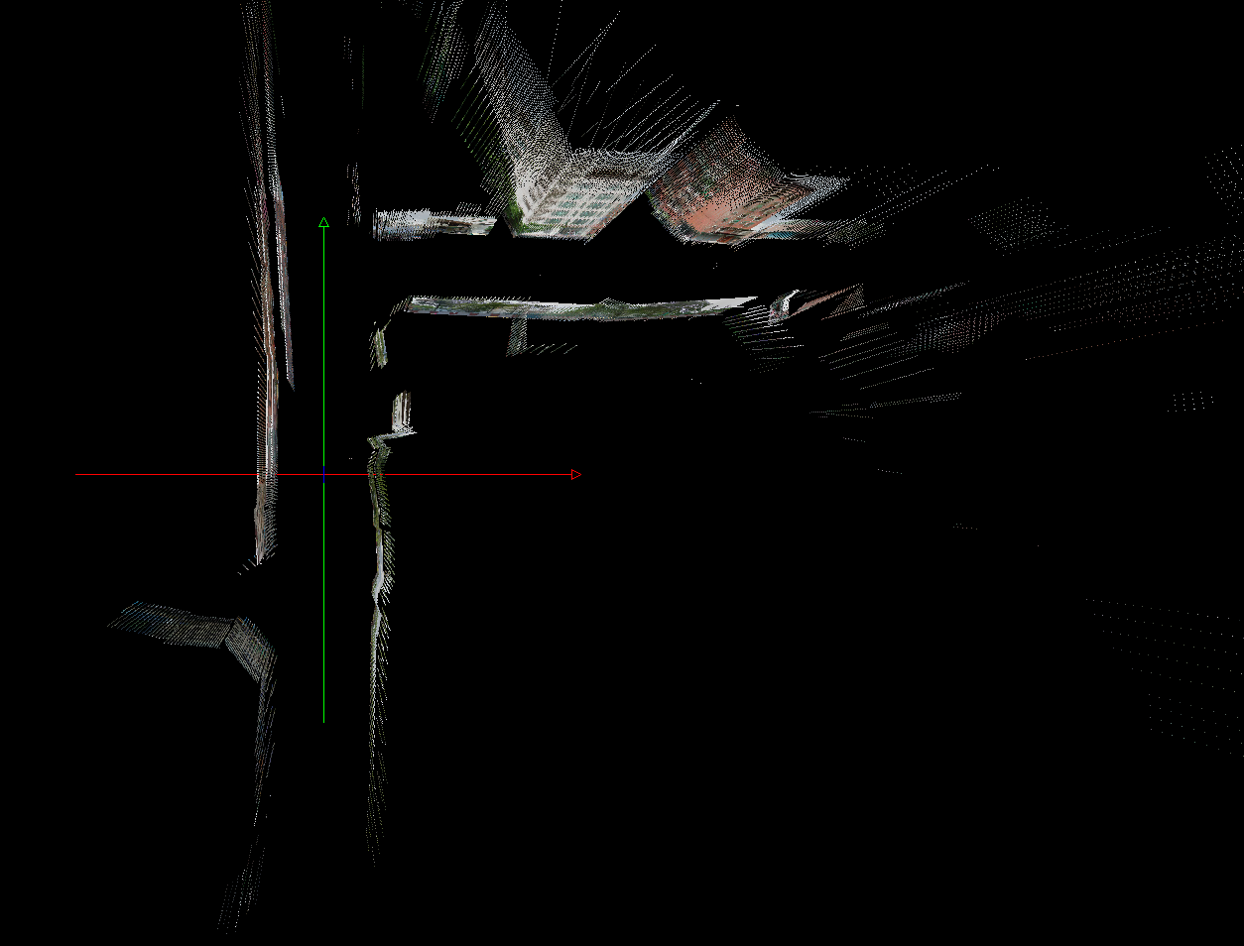
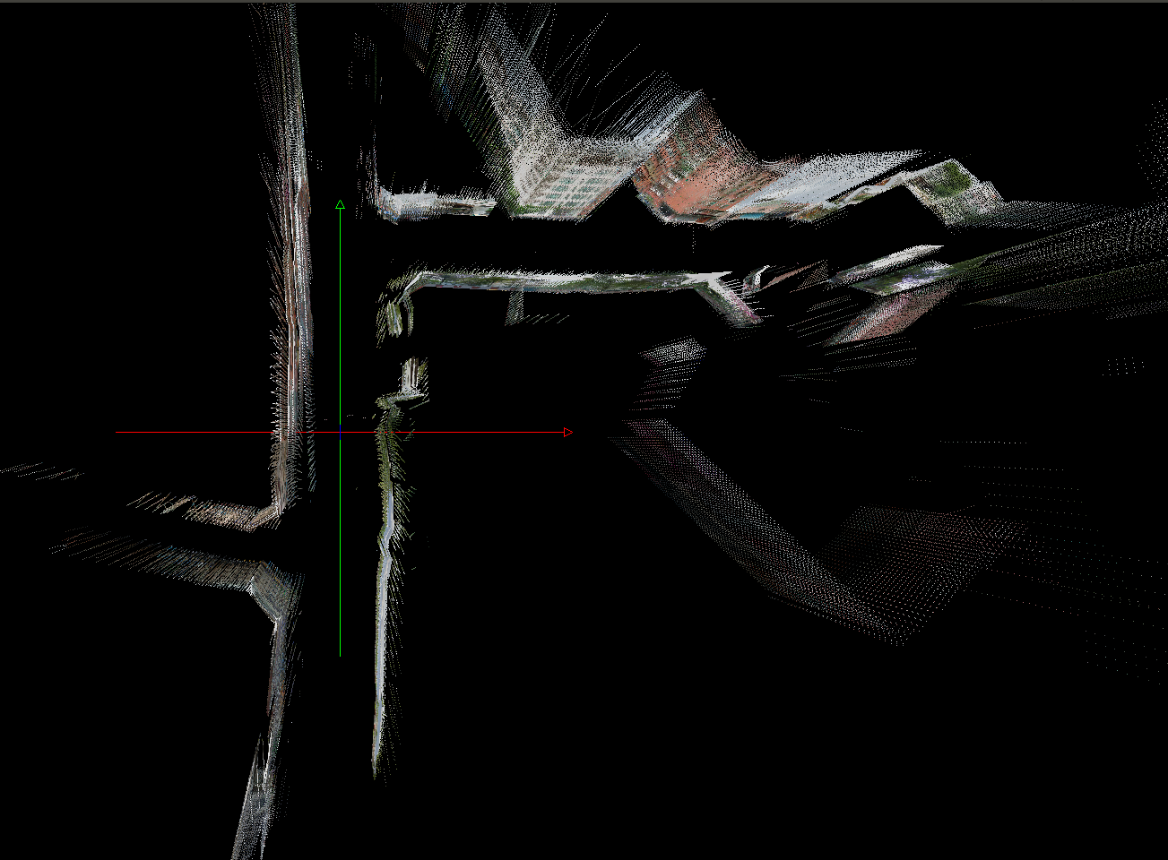
Info_3d
Trajectory

Slide 14
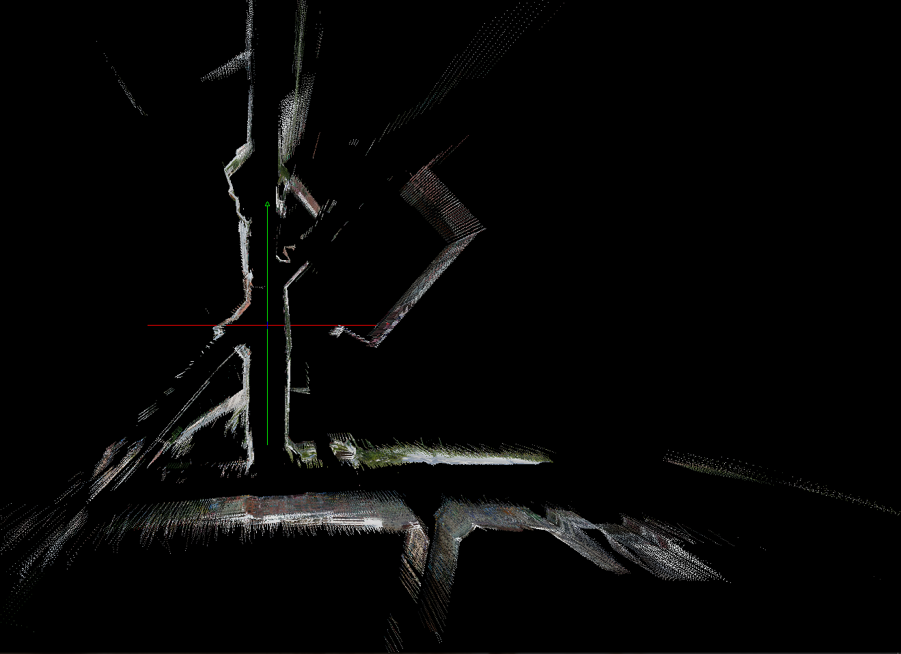
6.Create the SV3D according to trajectory(Now, it's important to use the correct anchor!!)
Correct anchor
Random anchor

Slide 15
7. Output the ply file of SV3D constructed from trajectory

Slide 16
